Slide 1

Intrusion Detection and Prevention
CIS 360 – Prof. C. R. Johnson
University of Wisconsin – Stevens Point

Slide 2






Intrusion Detection Systems (IDSs)
An attack is launched on a network that has a sensor deployed in promiscuous IDS mode; therefore copies of all packets are sent to the IDS sensor for packet analysis. However, the target machine will experience the malicious attack.
The IDS sensor, matches the malicious traffic to a signature and sends the switch a command to deny access to the source of the malicious traffic.
The IDS can also send an alarm to a management console for logging and other management purposes.
Switch
1
2
Sensor
3
Management Console
Target

Slide 3

Intrusion Prevention Systems (IPSs)
1
An attack is launched on a network that has a sensor deployed in IPS mode (inline mode).
The IPS sensor analyzes the packets as they enter the IPS sensor interface. The IPS sensor matches the malicious traffic to a signature and the attack is stopped immediately.
The IPS sensor can also send an alarm to a management console for logging and other management purposes.
Traffic in violation of policy can be dropped by an IPS sensor.
2
4
Sensor
Bit Bucket
3
Management Console
Target

Slide 4
IDS vs IPS

Slide 5
IDS vs IPS (2)

Slide 6
IDS vs IPS (3)

Slide 7
IDS Requirements
run continually
be fault tolerant
resist subversion
impose a minimal overhead on system
configured according to system security policies
adapt to changes in systems and users
scale to monitor large numbers of systems
provide graceful degradation of service
allow dynamic reconfiguration
Notes:
[BALU98] lists the following as desirable for an IDS. It must:
• run continually with minimal human supervision.
• be fault tolerant in the sense that it must be able to recover from system crashes and reinitializations.
• resist subversion. The IDS must be able to monitor itself and detect if it has been modified by an attacker.
• impose a minimal overhead on the system where it is running.
• be able to be configured according to the security policies of the system that is being monitored.
• be able to adapt to changes in system and user behavior over time.
• be able to scale to monitor a large number of hosts.
• provide graceful degradation of service in the sense that if some components of the IDS stop working for any reason, the rest of them should be affected as little as possible.
• allow dynamic reconfiguration; that is, the ability to reconfigure the IDS without having to restart it.

Slide 8
Network-Based Implementation
CSA
MARS
VPN
Remote Worker
Firewall
VPN
IPS
CSA
VPN
Iron Port
Remote Branch
CSA
CSA
CSA
Web Server
Email Server
DNS

Slide 9
Host-Based Implementation
CSA
CSA
MARS
VPN
Management Center for Cisco Security Agents
Remote Worker
Firewall
VPN
IPS
CSA
VPN
Agent
Remote Branch
Iron Port
CSA
CSA
CSA
CSA
CSA
CSA
Web Server
Email Server
DNS

Slide 10




Cisco Security Agent
Corporate Network
Application
Server
Agent
Agent
Firewall
Untrusted Network
Agent
Agent
Agent
Agent
SMTP Server
Agent
Agent
Agent
Web
Server
DNS
Server
Management Center for Cisco Security Agents

Slide 11
Comparing HIPS and Network IPS
 | Advantages | Disadvantages
HIPS | Is host-specific Protects host after decryption Provides application-level encryption protection | Operating system dependent Lower level network events not seen Host is visible to attackers
Network IPS | Is cost-effective Not visible on the network Operating system independent Lower level network events seen | Cannot examine encrypted traffic Does not know whether an attack was successful

Slide 12
Honeypots
are decoy systems
filled with fabricated info
instrumented with monitors / event loggers
divert and hold attacker to collect activity info
without exposing production systems
initially were single systems
more recently are/emulate entire networks
Notes:
A relatively recent innovation in intrusion detection technology is the honeypot. Honeypots are decoy systems that are designed to lure a potential attacker away from critical systems. Honeypots are designed to divert an attacker from accessing critical systems, collect information about the attacker’s activity, and to encourage the attacker to stay on the system long enough for administrators to respond. These systems are filled with fabricated information designed to appear valuable but that a legitimate user of the system wouldn’t access. Thus, any access to the honeypot is suspect. The system is instrumented with sensitive monitors and event loggers that detect these accesses and collect information about the attacker’s activities. Because any attack against the honeypot is made to seem successful, administrators have time to mobilize and log and track the attacker without ever exposing productive systems. Initial efforts involved a single honeypot computer with IP addresses designed to attract hackers. More recent research has focused on building entire honeypot networks that emulate an enterprise, possibly with actual or simulated traffic and data. Once hackers are within the network, administrators can observe their behavior in detail and figure out defenses.

Slide 13
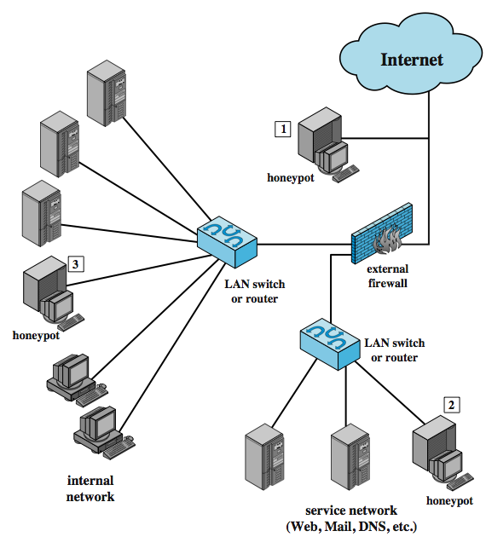
Honeypot Deployment
Notes:
Honeypots can be deployed in a variety of locations, as shown in Figure 6.6. The location depends on a number of factors, such as the type of information the organization is interested in gathering and the level of risk that organizations can tolerate to obtain the maximum amount of data. A honeypot outside the external firewall (location 1) is useful for tracking attempts to connect to unused IP addresses within the scope of the network. A honeypot at this location does not increase the risk for the internal network. The disadvantage of an external honeypot is that it has little or no ability to trap internal attackers, especially if the external firewall filters traffic in both directions. The DMZ is another candidate for locating a honeypot (location 2). The security administrator must assure that the other systems in the DMZ are secure against any activity generated by the honeypot. A disadvantage of this location is that a typical DMZ is not fully accessible, and the firewall typically blocks traffic to the DMZ the attempts to access unneeded services. Thus, the firewall either has to open up the traffic beyond what is permissible, which is risky, or limit the effectiveness of the honeypot. A fully internal honeypot (location 3) has several advantages in that it can catch internal attacks, and can also detect a misconfigured firewall that forwards impermissible traffic from the Internet to the internal network. There are several disadvantages. The most serious of these is if the honeypot is compromised so that it can attack other internal systems. Any further traffic from the Internet to the attacker is not blocked by the firewall because it is regarded as traffic to the honeypot only. Another difficult for this honeypot location is, as with location 2, the firewall must adjust its filtering to allow traffic to the honeypot, complicating firewall configuration and potentially compromising the internal network.

Slide 14
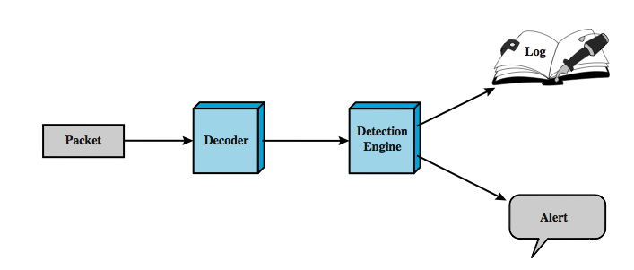
SNORT
lightweight IDS
real-time packet capture and rule analysis
passive or inline
Notes:
Snort is an open source, highly configurable and portable host-based or network-based IDS. Snort is referred to as a lightweight IDS. Snort can perform real-time packet capture, protocol analysis, and content searching and matching. Snort can detect a variety of attacks and probes, based on a set of rules configured by a system administrator. A Snort implementation can be configured as a passive sensor, which monitors traffic but is not in the main transmission path of the traffic, or an inline sensor. In the latter case, Snort can perform intrusion prevention as well as intrusion detection.
A Snort installation consists of four logical components, shown here in Figure 6.7:
• Packet Decoder: efficiently processes each captured packet to identify and isolate protocol headers at the data link, network, transport, and application layers.
• Detection Engine: does actual work of intrusion detection, analyzing each packet using rules defined for this configuration of Snort by the security administrator.
• Logger: of each packet that matches a rule, if specified. The security administrator can then use the log file for later analysis.
• Alerter: can be sent for each detected packet to a file, a UNIX socket, or a database.

Slide 15
SNORT Rules
use a simple, flexible rule definition language
with fixed header and zero or more options
header includes: action, protocol, source IP, source port, direction, dest IP, dest port
many options
example rule to detect TCP SYN-FIN attack:
Alert tcp $EXTERNAL_NET any -> $HOME_NET any \
(msg: "SCAN SYN FIN"; flags: SF, 12; \
reference: arachnids, 198; classtype: attempted-recon;)
Notes:
Snort uses a simple, flexible rule definition language that generates the rules used by the detection engine. Although the rules are simple and straightforward to write, they are powerful enough to detect a wide variety of hostile or suspicious traffic. Each rule consists of a fixed header and zero or more options. The header includes:
• Action: tells Snort what to do when it finds a packet that matches the rule criteria (alert, log, pass, activate, dynamic, drop, reject, sdrop)
• Protocol: if packet protocol matches this field then analysis proceeds
• Source IP address: source of packet
• Source port: for the specified protocol (e.g.,a TCP port).
• Direction: unidirectional (->) or bidirectional (<->).
• Destination IP address: destination of packet.
• Destination port
Following the rule header may be one or more rule options. Each option consists of an option keyword, which defines the option; followed by arguments, which specify the details of the option. Table 6.5 in the text gives examples of options in each category.
The example shown of a Snort rule checks detects a type of attack at the TCP level known as a SYN-FIN attack. It has specified source and destination networks, and checks if the SYN and the FIN bits are set, ignoring reserved bit 1 and reserved bit 2 in the flags octet. The reference option refers to an external definition of this attack, which is of type attempted-recon.

Slide 16
IDS/IPS Selection Factors
Factors that impact a sensor selection and deployment:
Amount of network traffic
Network topology
Security budget
Available security staff
Size of implementation
Small (branch offices)
Large
Enterprise

Slide 17
Understanding Triggers
False Positive – triggered but traffic is not malicious or important to the safety of the network
False Negative – malicious traffic but no trigger
True Positive – malicious traffic detected and sensor triggered (IDS – report, IPS – drop/block)
True Negative – normal traffic and no trigger (normal behavior)

Slide 18
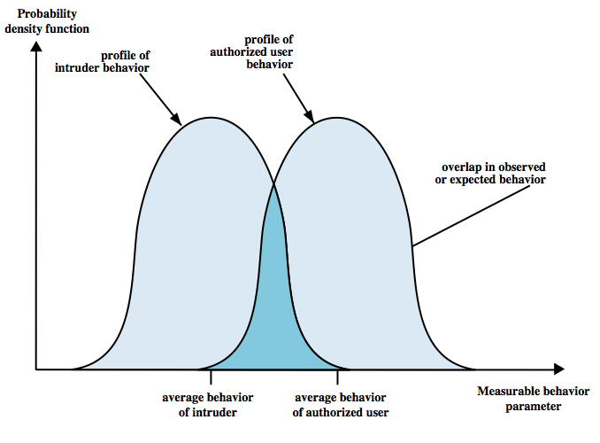
IDS Principles
assume intruder behavior differs from legitimate users
expect overlap as shown
observe deviations
from past history
problems of:
false positives
false negatives
must compromise
Notes:
Intrusion detection is based on the assumption that the behavior of the intruder differs from that of a legitimate user in ways that can be quantified. Of course, we cannot expect that there will be a crisp, exact distinction between an attack by an intruder and the normal use of resources by an authorized user. Rather, we must expect that there will be some overlap, as shown by Figure 6.1. Patterns of legitimate user behavior can be established by observing past history, and significant deviation from such patterns can possibly be detected. Although the typical behavior of an intruder differs from the typical behavior of an authorized user, there is an overlap in these behaviors. Thus, a loose interpretation of intruder behavior, which will catch more intruders, will also lead to a number of false positives, or authorized users identified as intruders. On the other hand, an attempt to limit false positives by a tight interpretation of intruder behavior will lead to an increase in false negatives, or intruders not identified as intruders. Thus, there is an element of compromise and art in the practice of intrusion detection.

Slide 19
Identifying Malicious Traffic on the Network
 | Advantages | Disadvantages
Signature-based Detection | Easy configuration Fewer false positives Good signature design | No detection of unknown signatures Initially a lot of false positives Signatures must be created, updated, and tuned
Anomaly-based Detection | Simple and reliable Customized policies Can detect unknown attacks | Generic output Policy must be created
Policy-based Detection | Easy configuration Can detect unknown attacks | Difficult to profile typical activity in large networks Traffic profile must be constant
Honey Pot-Based Detection | Window to view attacks Distract and confuse attackers Slow down and avert attacks Collect information about attack | Dedicated honey pot server Honey pot server must not be trusted

Slide 21
Possible Responses

Slide 23
Which Actions the Sensors Should Take
Become laborious as the number of signatures kept increasing – track and manage the individual actions for each signature
Solutions?
Let the sensor consider how significant the risk is and take appropriate actions. How?
Risk rating

Slide 24
Risk Rating Calculation Factors

Slide 25
Circumventing and IDS/IPS

Slide 27
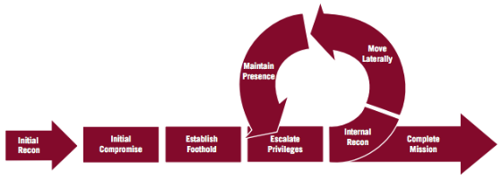
Attack Lifecycle
Concept of Attack lifecycle*
7 - Stages common to most Intrusions
Initial Compromise
Establish foothold
Escalate privileges
Internal reconnaissance
Move Laterally
Maintain presence
Complete mission
Not all stages are always present in all of the intrusions.
* (note: Mandiant Attack Lifecycle)

Slide 28
LifeCycle
Initial Compromise: Attacker successfully executes malicious codes on one or more systems. Often occurs through social engineering such as Spear Phishing
Establish Foothold: Attacker ensures remote access to a recently compromised system. Attacker installs a backdoor

Slide 29
Lifecycle
Escalate Privileges: attacker obtains greater access to systems and data that was initially available.
Password Hash or token dumping
Password cracking
Obtaining access to user accounts
Internal Reconnaissance
Attacker explores the environment for better understanding of key systems and key information

Slide 30
Lifecycle
Move Lateral: attacker moves from system to system to gain a larger foothold.
Utilizes network shares,
Windows Task Scheduler to execute programs
Remote access via tools such as PsExec, Radmin, etc.
Maintain Presence
Maintain multiple backdoors on additional systems compromised.

Slide 31
Lifecycle
Complete Mission: Exfiltration of data, leave additional backdoors, hide traces and tracks of breaches.

Slide 32
INCIDENT RESPONSE
What is incident response?
What are the goals of Incident Response?
What constitutes a response?

Slide 33
INCIDENT RESPONSE
What is incident response?
Incident response is an organized and a structured approach to addressing and managing the aftermath of a security breach or attack (also known as an incident)

Slide 34
INCIDENT RESPONSE
What are the goals of incident response?
Primary goal is to effectively remove a threat from the organization’s environment while minimizing damage and restoring normal operations.

Slide 35
INCIDENT RESPONSE
Activities
Confirm whether or not an incident occurred
Provide a rapid detection and containment
Determine and document the scope of the incident
Prevent a disjointed, noncohesive response
Determine and promote facts and actual information
Minimize disruption to business and network operations

Slide 36
INCIDENT RESPONSE
Activities
Minimize the damage to the compromised organization
Restore normal operations
Manage the public perception of the incident
Allow for criminal or civil actions against perpetrators
Educate senior management
Enhance senior management
Enhance the security posture of a compromised entity against future incidents

Slide 37
INCIDENT RESPONSE
Activities can be grouped in two specific segments
Investigate
Remediate

Slide 38
INCIDENT RESPONSE
Investigate
Determine the initial attack vector
Determine the malware and tools used
Determine what systems were affected and how
Determine what the attacker accomplished
Determine if the incident is ongoing
Establish the time frame of the incident
Remediate
Develop and implement remediation plan

Slide 39
Incident Response Plan (IRP)
Preparation
Plan PRIOR to Incident
Identification
Determine what is/has happened
Containment
& Escalation
Limit incident
[If data breach]
Analysis &
Eradication
Determine and remove
root cause
Notification
Notify any data
breach victims
Recovery
Return operations
to normal
Ex-Post
Response
Establish call center,
reparation activities
Lessons
Learned
Process improvement:
Plan for the future
Notes:
The next slides will go through these steps in detail.
Source: CISM® Review Manual 2009, © 2008, ISACA. All rights reserved. Used by permission.

Slide 40
Stage 1: Preparation
What shall we do if different types of incidents occur? (BIA helps)
When is the incident management team called?
How can governmental agencies or law enforcement help?
When do we involve law enforcement?
What equipment do we need to handle an incident?
What shall we do to prevent or discourage incidents from occurring? (e.g. banners, policies)
Where on-site & off-site shall we keep the IRP?
Notes:
A business impact assessment (BIA) should be conducted by each business process (department, whatever) to determine how an incident will affect it and what steps should be taken to mitigate or respond to it. This is part of risk management as well as incident response.
The incident response plan (IRP) is the document that contains procedures to follow in case of an emergency (see slide 11). It should be usable by someone who wasn’t involved in its creation, and needs to be accessible in unusual circumstances – if the only copy is in your desk drawer when a fire guts your office building, then you’re doing it wrong.
Bullet 3, 4: meet with government emergency management (law enforcement, etc) to learn what they are capable of and how they prefer to operate.

Slide 41
Stage 1: Preparation
Data Collection
SkillsSet - Team
Appropriate Authority
Existing Assets
Notes:
A business impact assessment (BIA) should be conducted by each business process (department, whatever) to determine how an incident will affect it and what steps should be taken to mitigate or respond to it. This is part of risk management as well as incident response.
The incident response plan (IRP) is the document that contains procedures to follow in case of an emergency (see slide 11). It should be usable by someone who wasn’t involved in its creation, and needs to be accessible in unusual circumstances – if the only copy is in your desk drawer when a fire guts your office building, then you’re doing it wrong.
Bullet 3, 4: meet with government emergency management (law enforcement, etc) to learn what they are capable of and how they prefer to operate.

Slide 42
Preparation - Data Collection
Proactive Detection includes:
Network Intrusion Detection/Prevention System (NIDS/NIPS)
Host Intrusion Detection/Prevention System (HIDS/HIPS)
Antivirus, Endpoint Security Suite
Security Information and Event Management (Logs)
Vulnerability/audit testing
System Baselines, Sniffer
Centralized Incident Management System
Input: Server, system logs
Coordinates & co-relates logs from many systems
Tracks status of incidents to closure
Reactive Detection: Reports of unusual or suspicious activity
Notes:
You can’t determine if an incident has occurred unless there are detection techniques. It makes sense that there is a detection technique and/or metric for each risk of concern. The above tools do not need to be implemented, depending on the decision of risk assessment. However, they are useful tools for detecting incidents.

Slide 43
Incidents may include…
Employees Reports
Malware
Violations of policy
Data breach:
stolen laptop, memory
employee mistake
Social engineering/fraud:
caller, e-mail, visitors
Unusual event:
inappropriate login
unusual system aborts
server slow
deleted files
defaced website
IT Detects
a device (firewall, router or server) issues serious alarm(s)
an IDS/IPS recognizes an irregular pattern:
unusually high traffic,
inappropriate file transfer
changes in protocol use
unexplained system crashes or
unexplained connection terminations

Slide 44
Preparation - Skills
Do we have the right skill set
Does the skill set have to be developed
Do we outsource
???

Slide 45
Preparation – Appropriate Authority
Do we have the authority to do what needs to be done?
Do we have a plan that has been approved?

Slide 46
Stage 2 - Identification
Triage: Categorize, prioritize and assign events and incidents
What type of incident just occurred?
What is the severity of the incident?
Severity may increase if recovery is delayed
Who should be called?
Establish chain of custody for evidence
Notes:
You may remember from MASH (TV show and movie) that Triage is about stopping bleeding and prioritizing injuries to maximize the probability of survival. Same thing here: determining what is wrong and taking the correct first actions until the bleeding stops and the experts are ready to take over.
How to declare a disaster involves more than communication; it also means when to declare a disaster, as opposed to some lesser incident. You want your response to be proportional to the scale of the incident . If you overreact (shutting down the entire network over one unauthorized entry) you’ll waste a lot of time and money. If you underreact, the incident may become a lot worse than it already is.

Slide 47
Identification - Triage
Snapshot of the known status of all reported incident activity
Sort, Categorize, Correlate, Prioritize & Assign
Categorize: DoS, Malicious code, Unauthorized access, Inappropriate usage, Multiple components
Prioritize: Limited resources requires prioritizing response to minimize impact
Assign: Who is free/on duty, competent in this area?
Notes:
Triage happens at a hospital: When you come in you are asked questions to determine how long you can wait to see a doctor. (You get prioritized compared to the other emergency patients.) They may bandage you to stop any bleeding, but think military war zone: a full operation is not done.

Slide 48
Identification - Chain of Custody
Evidence must follow Chain of Custody law to be admissible/acceptable in court
Include: specially trained staff, 3rd party specialist, law enforcement, security response team
System administrator can:
Retrieve info to confirm an incident
Identify scope and size of affected environment (system/network)
Determine degree of loss/alteration/damage
Identify possible path of attack
Notes:
Chain of Custody will be necessary if anything will go to court. Need to be concerned with this right from the start, if a concern.
Chain of Custody requires that a witness be present for all actions taken, that a qualified ‘expert’ does the incident response and forensic work (or the work accomplished stands up in court as professional), that the original disk is not modified, and that the whereabouts of the disk is always secure from the point of the incident on – locked, limited key access, witnessed, etc.

Slide 49
Stage 3 - Containment
Activate Incident Response Team to contain threat
IT/security, public relations, mgmt, business
Isolate the problem
Disable server or network zone comm.
Disable user access
Change firewall configurations to halt connection
Obtain & preserve evidence
Notes:
Employees who are not directly involved in incident response still need to know their roles, even if its just to get out of the way and let the IRT work.
The proper actions are defined in the Incident Response plan, which should always be followed. For example, no one should be talking to the news accept public relations or top management.

Slide 50
Containment - Response
Technical
Collect data
Analyze log files
Obtain further technical assistance
Deploy patches & workarounds
Managerial
Business impacts result in mgmt intervention, notification, escalation, approval
Legal
Issues related to: investigation, prosecution, liability, privacy, laws & regulation, nondisclosure
Notes:
Issues may affect IT, management, and even legal, depending on the incident.

Slide 51
Stage 4 - Analysis & Eradication
Determine how the attack occurred: who, when, how, and why?
What is impact & threat? What damage occurred?
Remove root cause: initial vulnerability(s)
Rebuild System
Talk to ISP to get more information
Perform vulnerability analysis
Improve defenses with enhanced protection techniques
Discuss recovery with management, who must make decisions on handling affecting other areas of business
Notes:
Forensics can be a useful tool here.
Rebuilding may be necessary is someone attacked your computer – and entered as admin in particular. While some of the malware may be detected, it is possible that backdoors and rootkit parts may not be detected – including replaced OS software or new login/passwords added. So you may know part of what the attacker did, but not all. It would be best to rebuild the entire system, when in doubt, if security is a concern.

Slide 52
Analysis
What happened?
Who was involved?
What was the reason for the attack?
Where did attack originate from?
When did the initial attack occur?
How did it happen?
What vulnerability enabled the attack?
Notes:
Here it is time to determine the root of the problem and its effects.

Slide 53
Remove root cause
If Admin or Root compromised, rebuild system
Implement recent patches & recent antivirus
Fortify defenses with enhanced security controls
Change all passwords
Retest with vulnerability analysis tools

Slide 54
Recovery
Restore operations to normal
Ensure that restore is fully tested and operational
Ensure that the restore has also not been compromised.

Slide 55
Stage 6: Lessons Learned
Follow-up includes:
Writing an Incident Report
What went right or wrong in the incident response?
How can process improvement occur?
How much did the incident cost (in loss & handling & time)
Present report to relevant stakeholders
Notes:
This slide refers mainly to the incident process itself and how to make it better for the next time. However it is also a good time to review preventative measures. Were they adequate (given that they failed) and was the cost of the incident high enough to justify spending more resources in order to avoid another?

